Slide 1
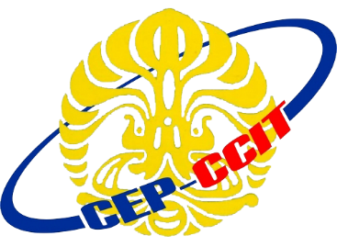
Physco Test Application
Using RMI (Remote Method Invocation)
Muhammad Naufal P.P.
Ugi Ispoyo Widodo

Slide 2
Background
Physco Test Application is a application that facilitates student to have a test without paper, to simpler the way of test system, calculates the score in instant and automatically sending the data to the database. The application stores the questions and the score of each student, so a student can view the score test easily.

Slide 3
System Analysis
There are 2 application used, Server Application and Client Application
This application has user as College Student
User can answer the question with the limited time and can view the test result in instant

Slide 4
How RMI Works?

Slide 5
Run The Program

Slide 6
Psyco Test Application
Thanks For Your Attention...

